Slide 1
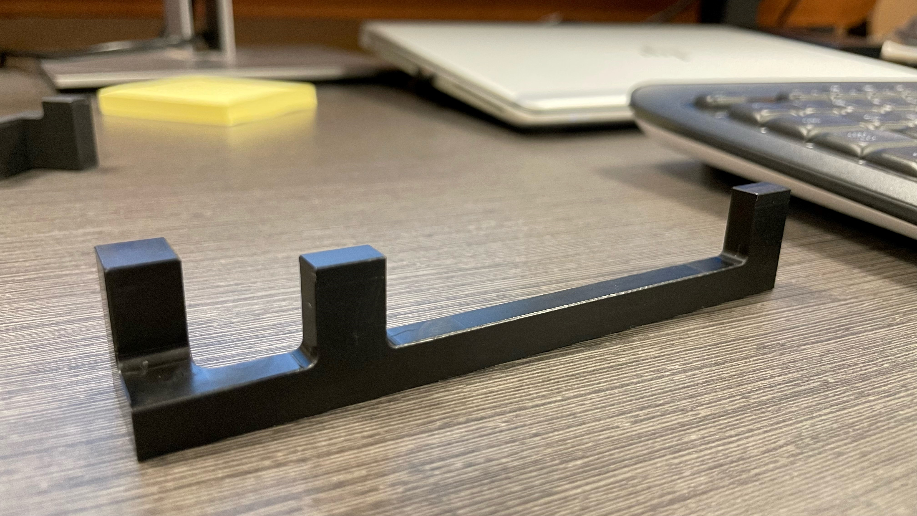
Original
Material: Acetal
Fill: Solid

Slide 2
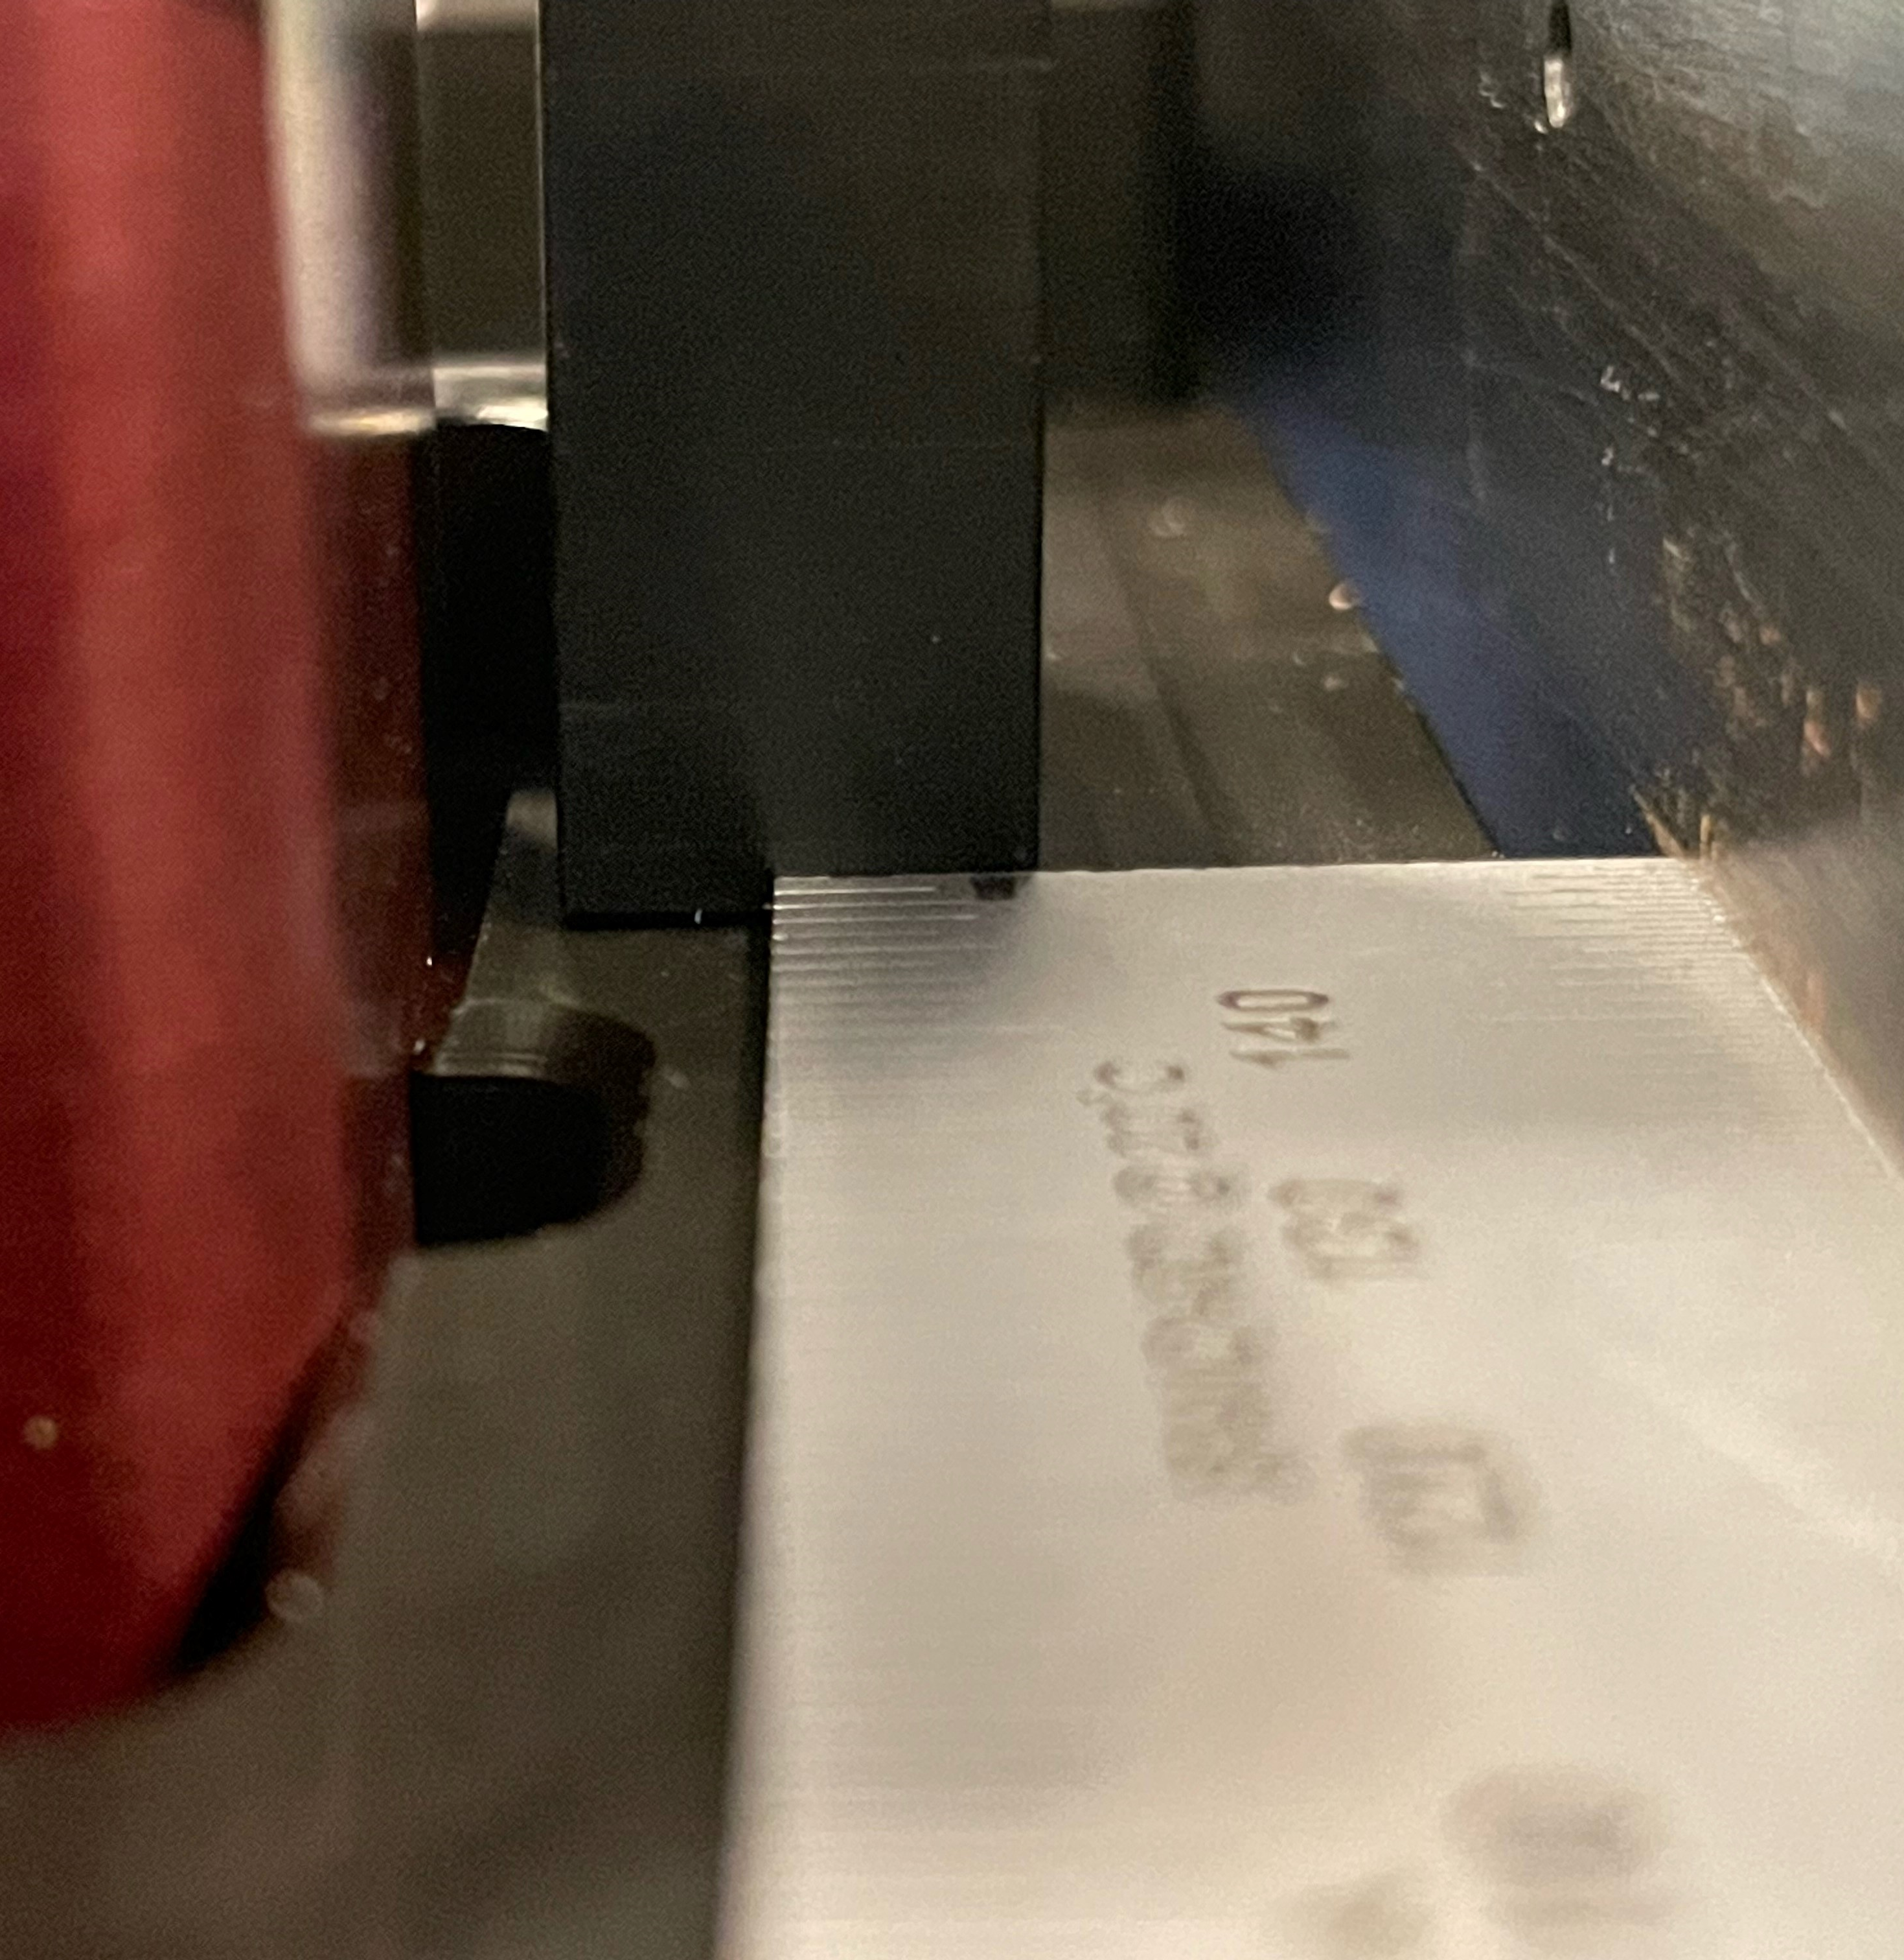
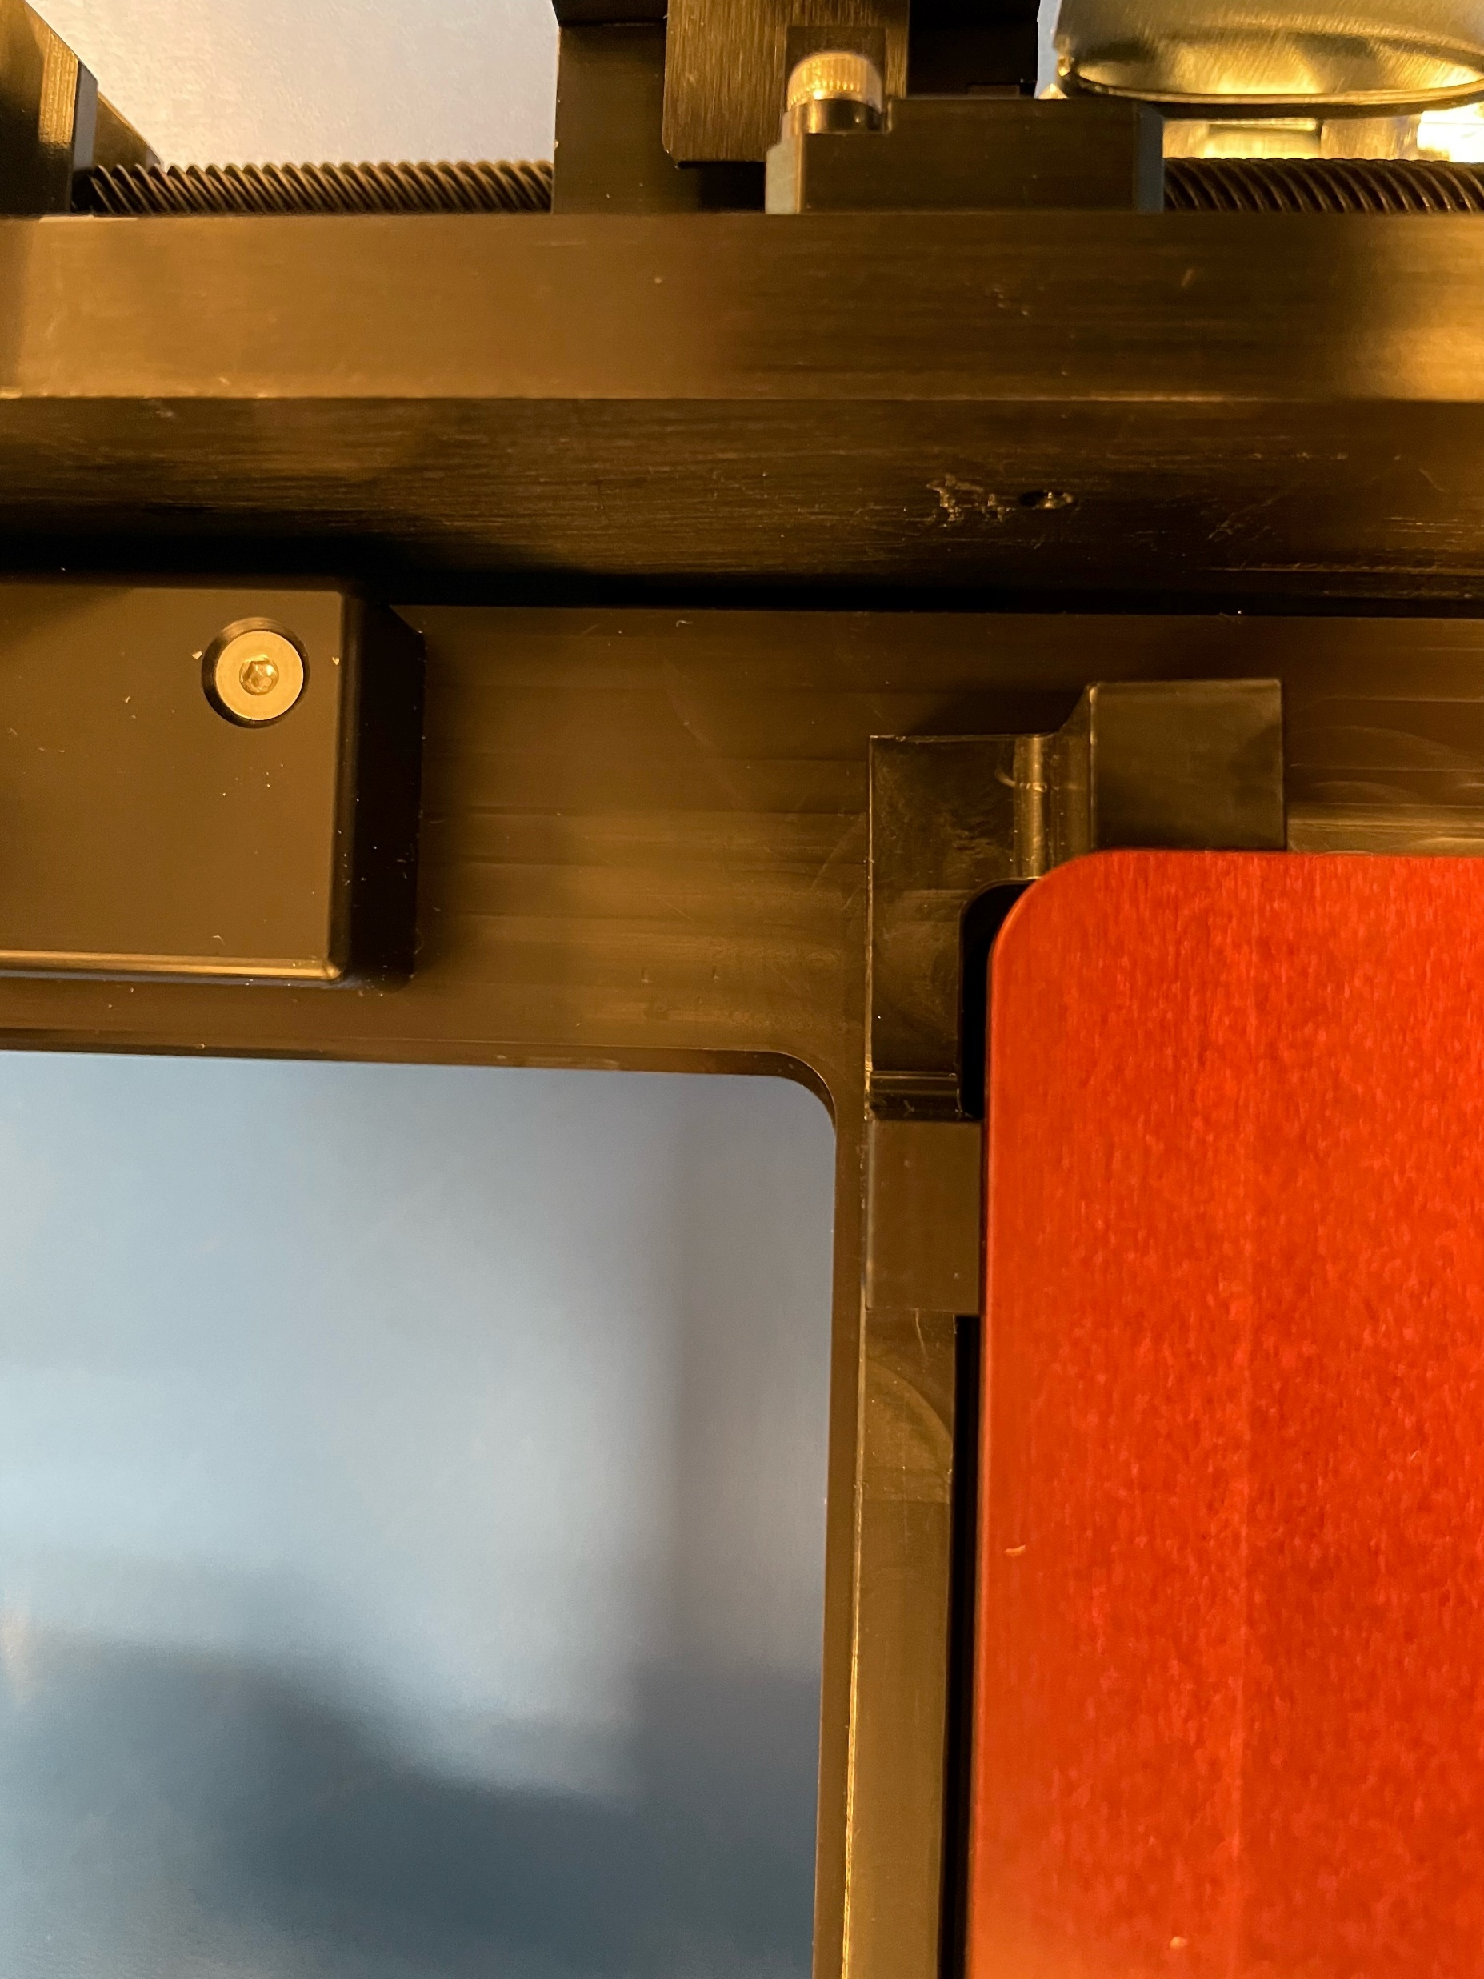
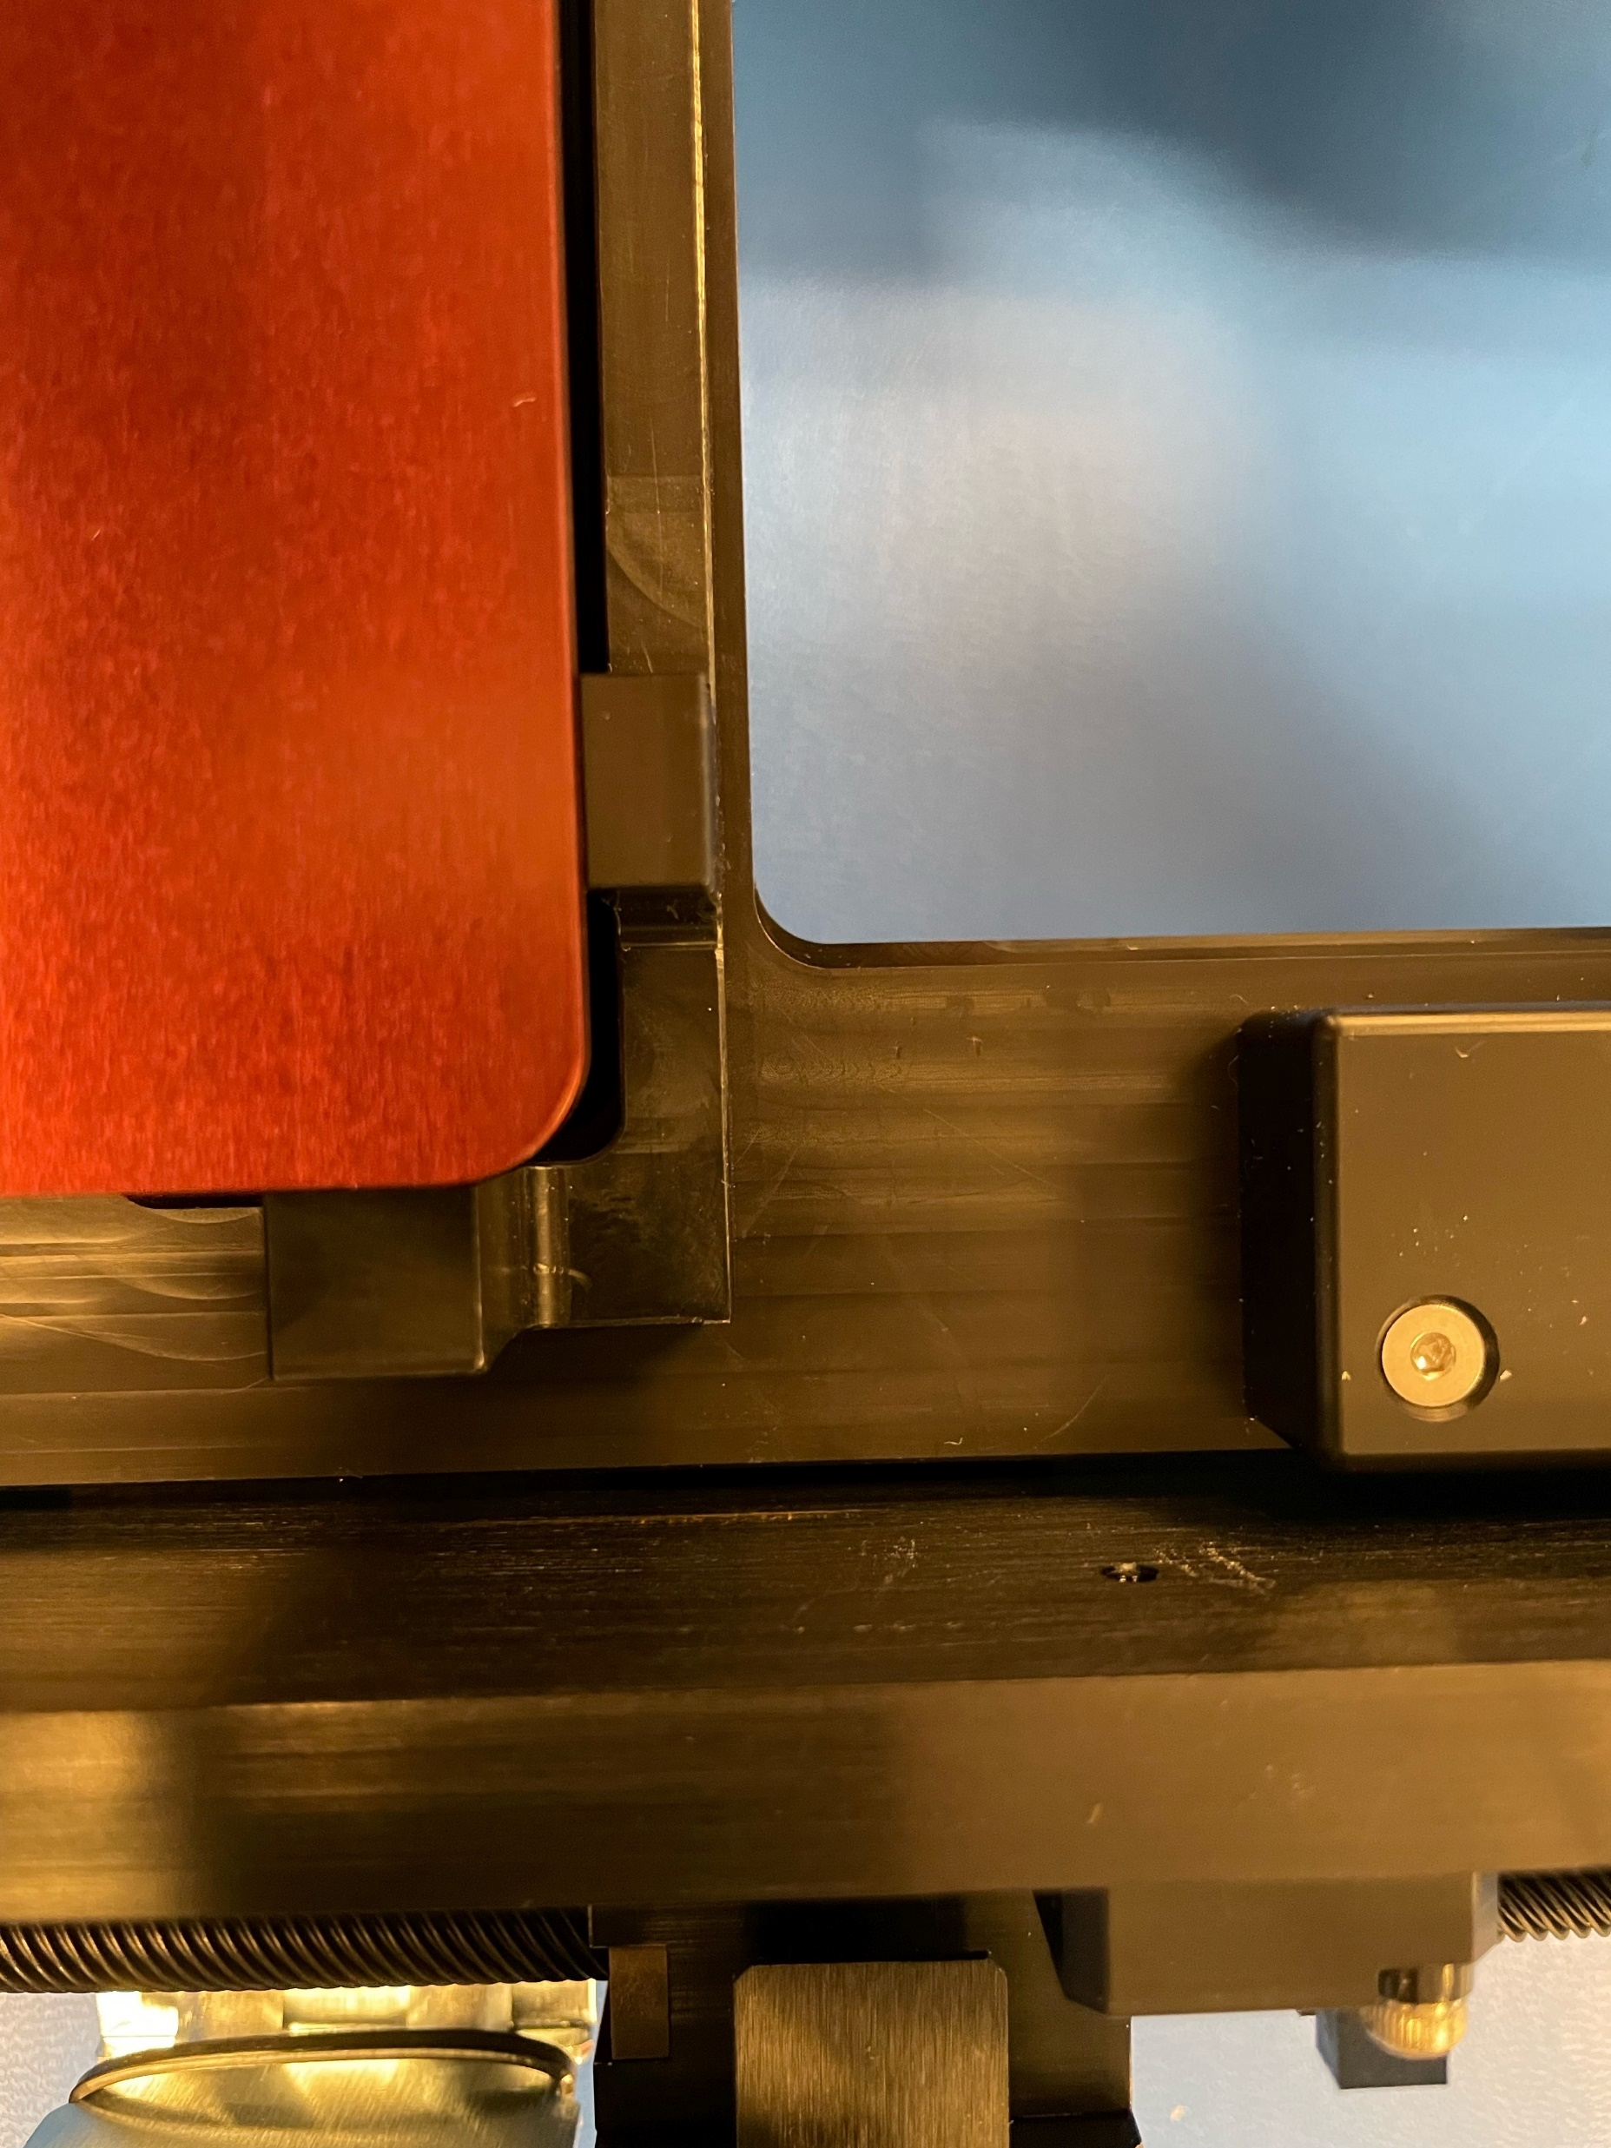
Original
Side view after torque
After torque
Before torque
Measurements
Screw distance before bend: ~ 1.75 mm
Ruler distance:
Severity of bend:
Medium

Slide 3
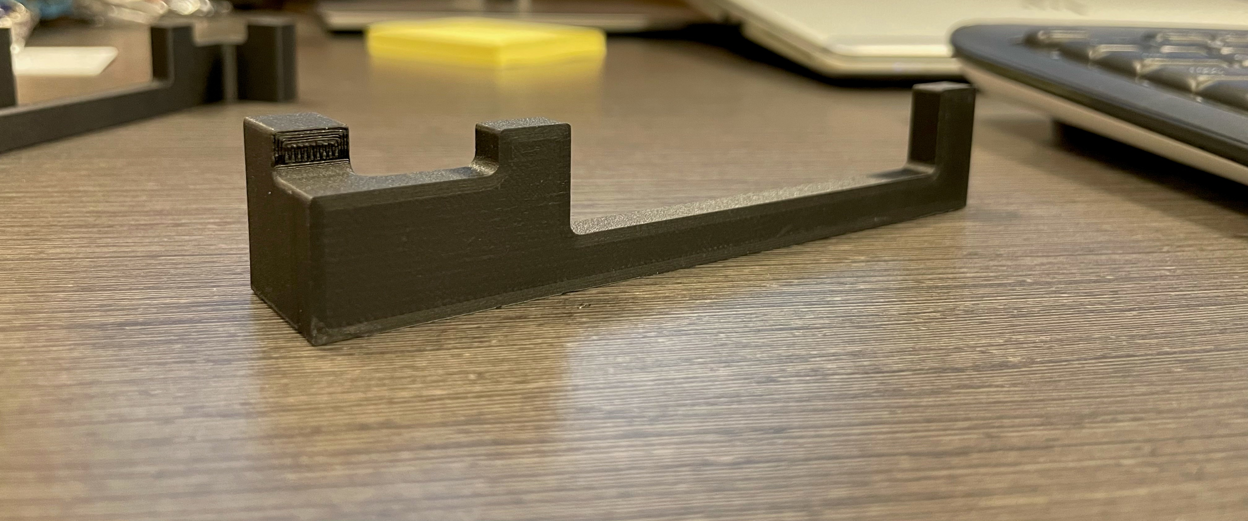
Rev 1
Material: Onyx
Fill: Standard with thin walls
Print base: Flat side

Slide 4
Material Description Link:

Slide 5
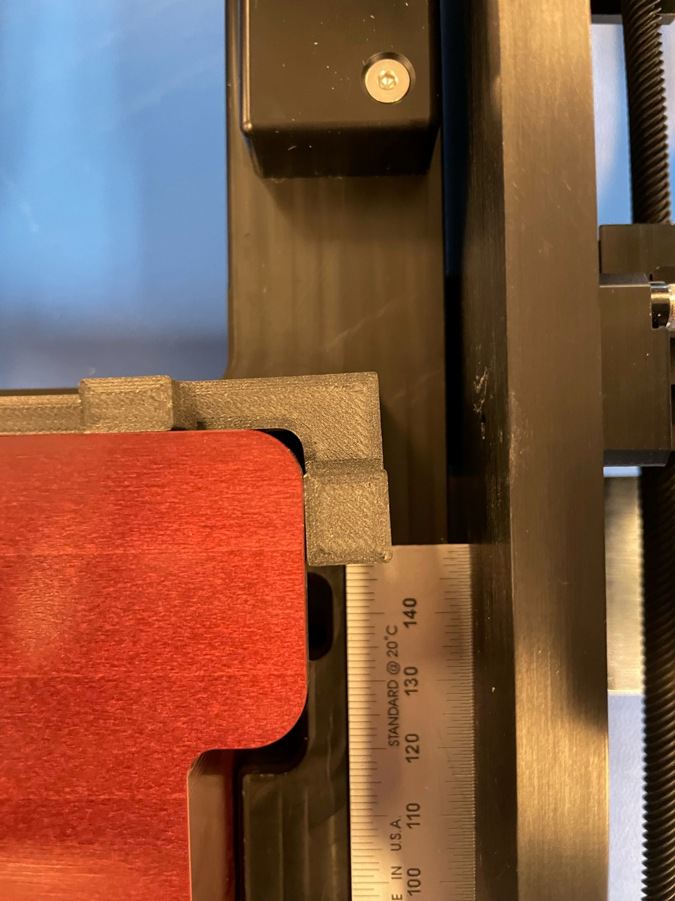
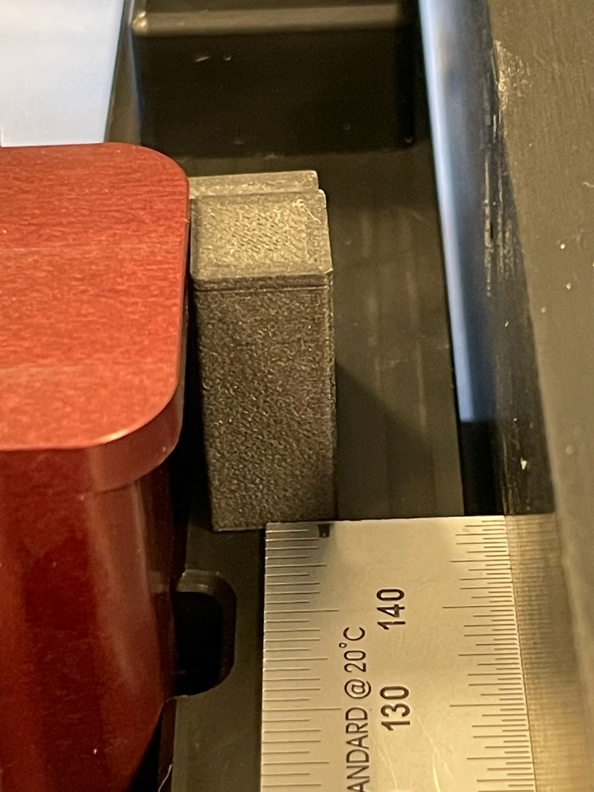
Rev 1
Measurements
Screw distance before bend: ~ 1.0 mm
Ruler distance:
Severity of bend:
High

Slide 6
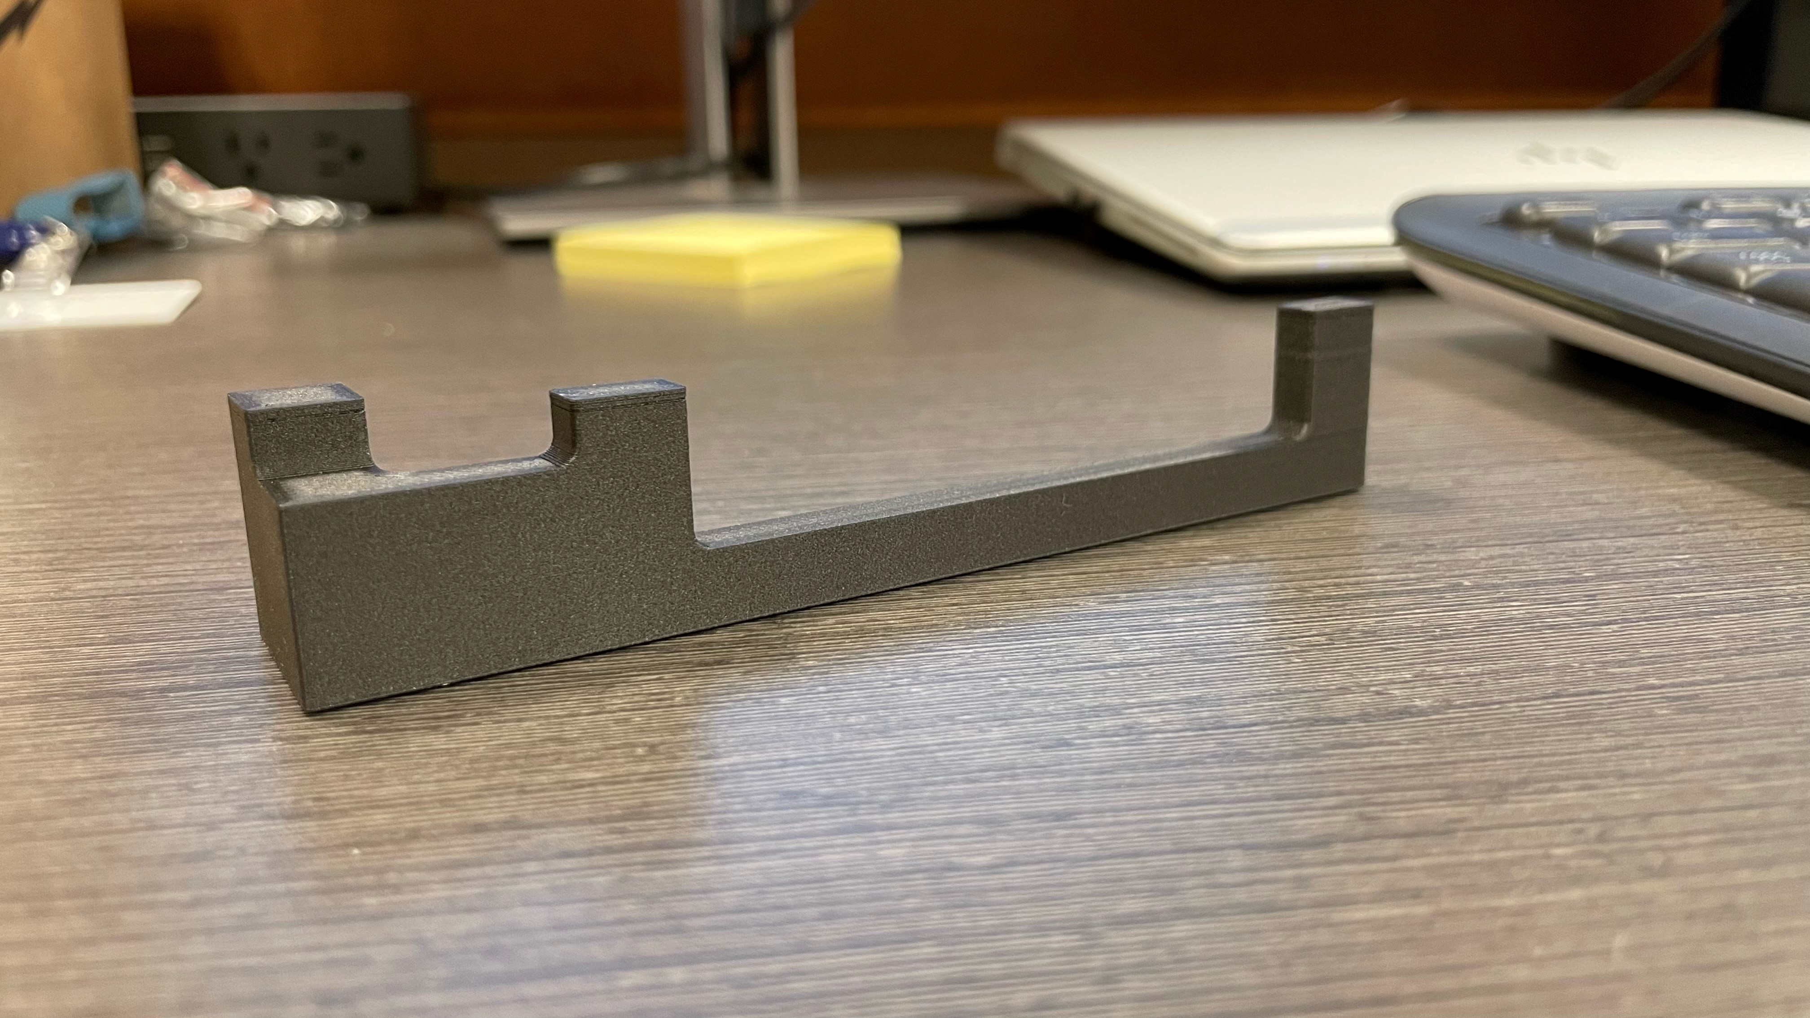
Rev 2
Material: Onyx
Fill: Triangular with Thick walls
Print Base: Bottom

Slide 7
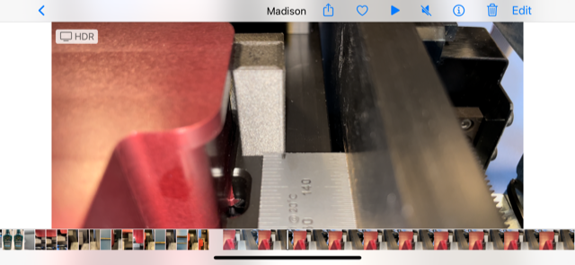
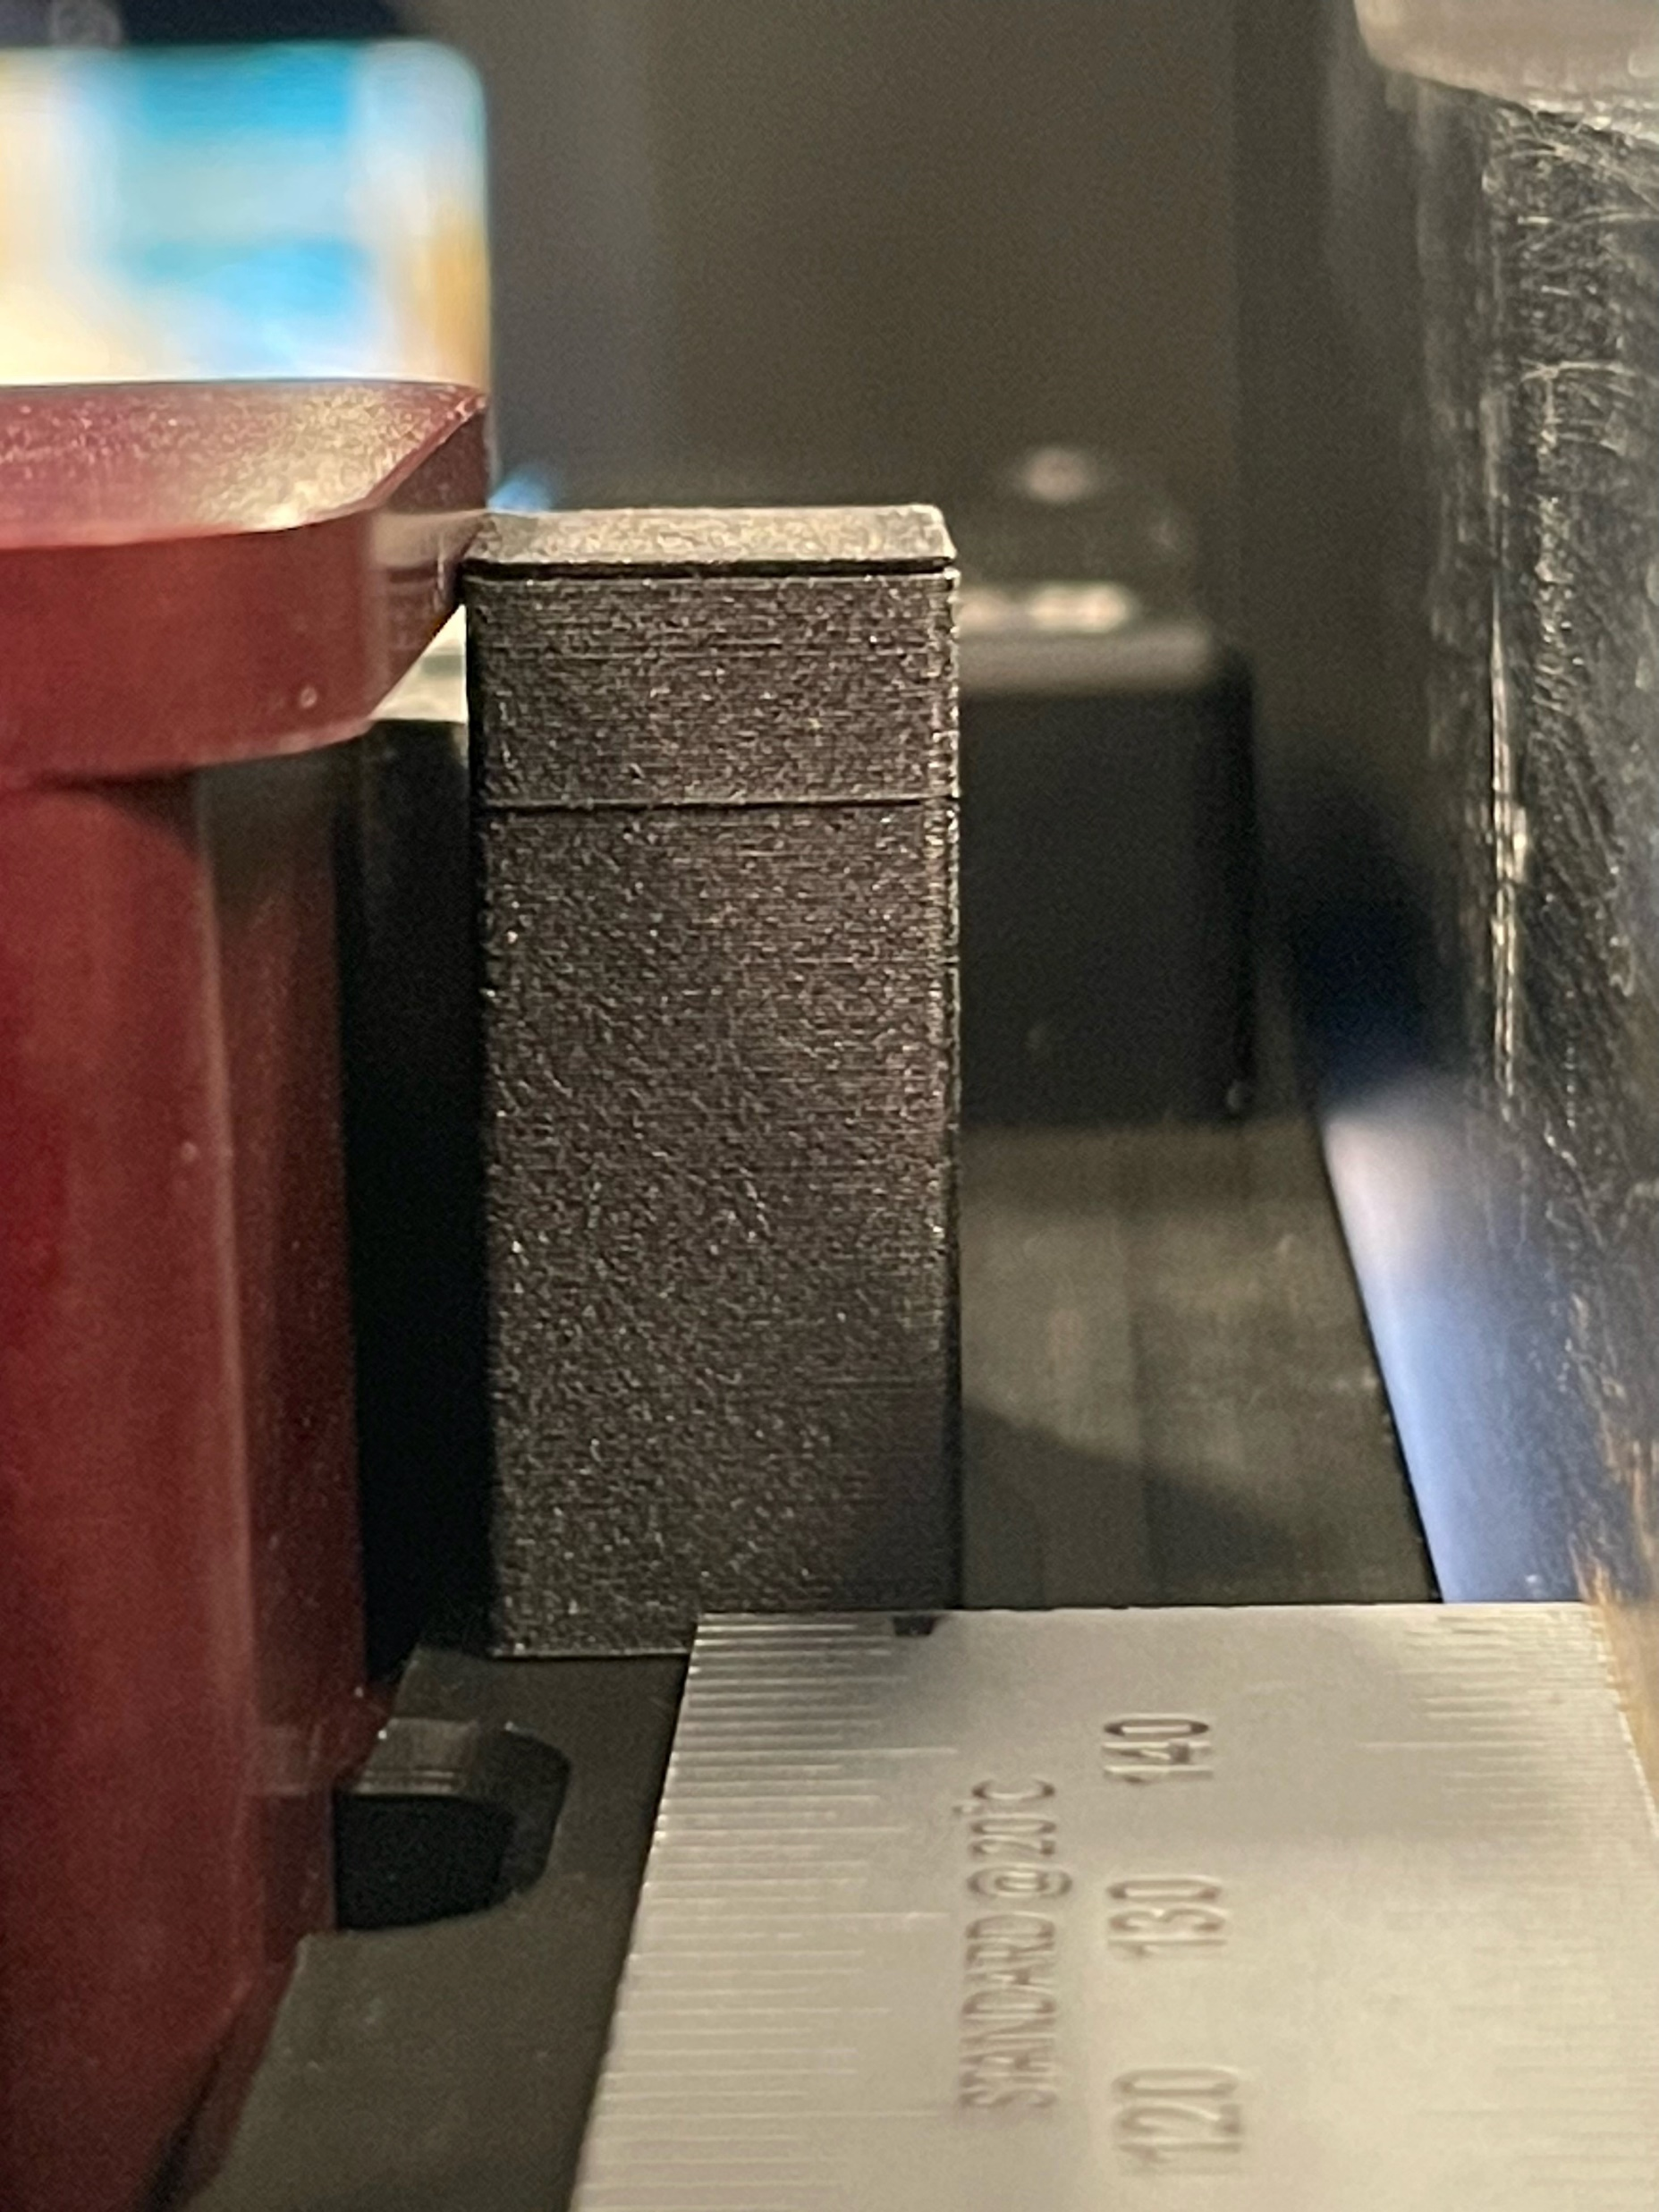
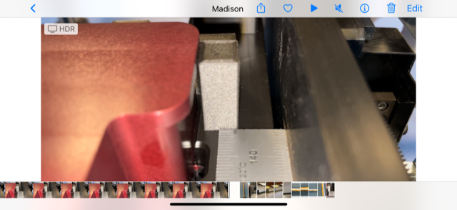
Rev 2
Resting position
Measurements
Screw distance before bend: ~ 2.0 mm
Ruler distance:
Severity of bend:
low
After tightening

Slide 8
Rev 3
Material: Onyx
Fill: complete fill
Print Base: Bottom

Slide 9
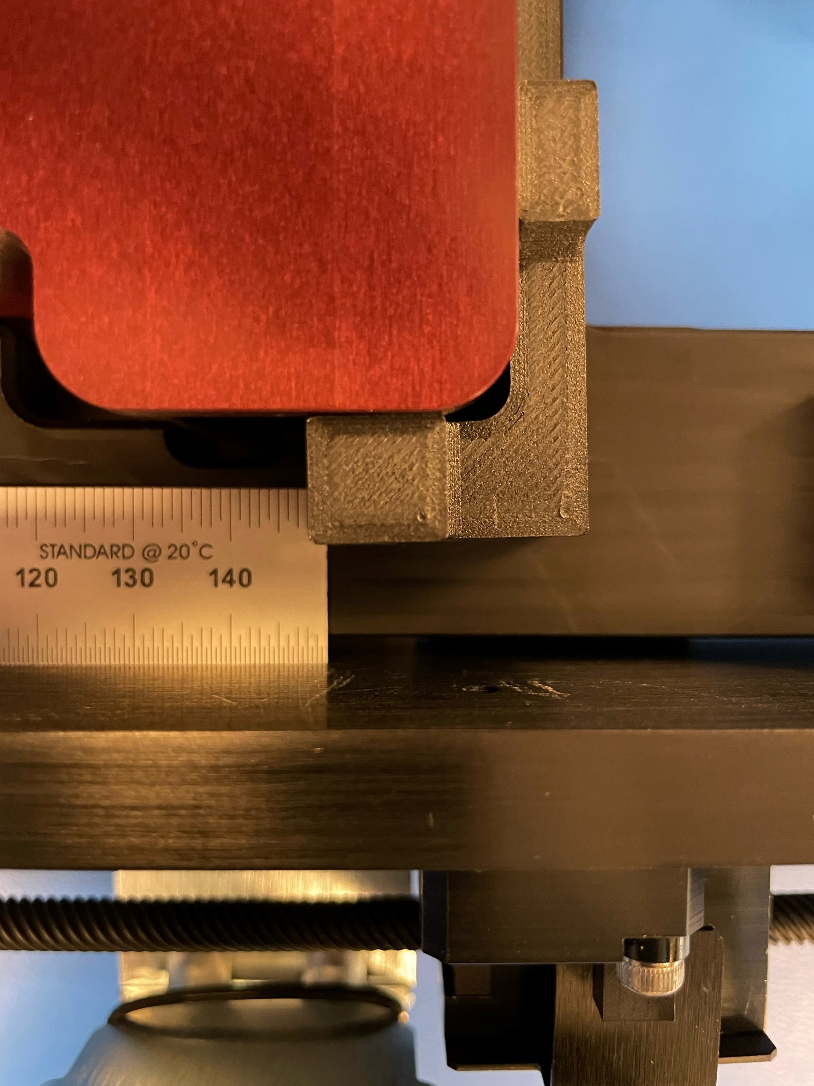
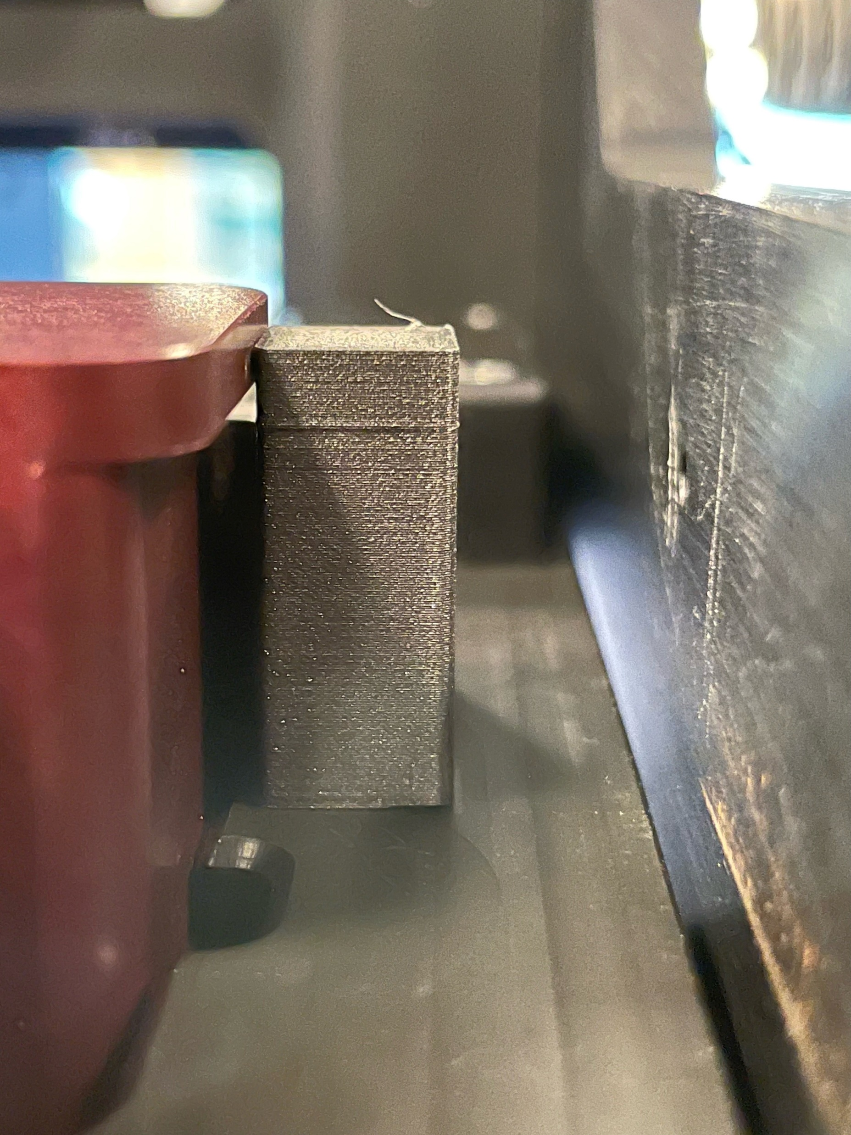
Rev 3
Overhead after tightening
Measurements
Screw distance before bend: ~ 2.2 mm Ruler distance:
Severity of bend:
minimal
Side view after tightening

